Slide 1
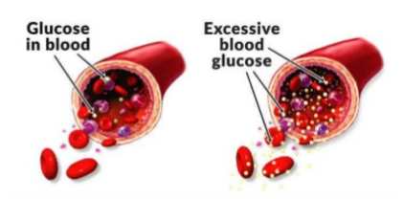
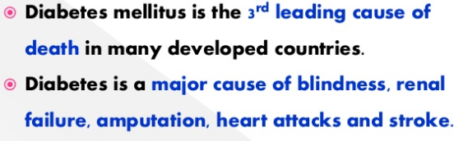
Diabetes mellitus

Slide 2
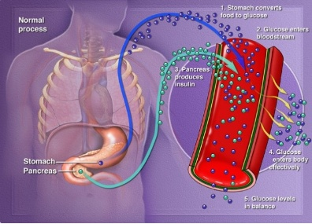

Slide 3
Diabetes mellitus refers to a chronic metabolic disorder that prevents the body to utilize glucose completely or partially.
It is characterised by raised glucose in the blood and altered carbohydrate , protein and fat metabolism.
Diabetes is therefore , a group of metabolic disorders, caused by improper functioning of hormone insulin(formation , liberation and action).
The underlying cause of diabetes varies by type. But, no matter what type of diabetes the person has , it leads to excess sugar in the blood.
Too much sugar in the blood can lead to serious health problems.

Slide 4
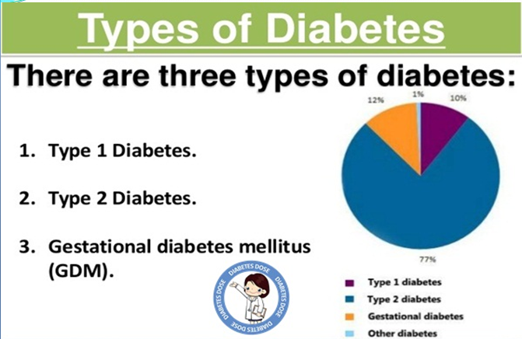

Slide 5
Type I DM, also known as JUVENILE ONSET DIABETES .
It is Insulin dependent diabetes.
The pancreas are unble to produce adequate amount of insulin.
May be due to viral infection or autoimmune disorder.
Acidosis is fairly common.
In adults there is slower onset of the disease which is referred to as Latent Auto Immune Diabetes Of Adults(LADA)

Slide 6
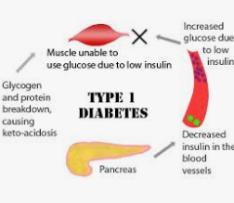
Types of Diabetes Mellitus

Slide 7
Type II DM it is adult onset diabetes .
It is Non –Insulin dependent diabetes
Develops slowly and is usually milder and more subtle.
There may be production of Insulin in the pancreas but its action is impared.
It usually occurs in adults and obese or overweight subjects.
Acidosis is frequent.
In majority of patients the condition improves on weight reduction and diet therapy.
Women with large babies and large families are prone to have this type of diabetes in later part of life.

Slide 8
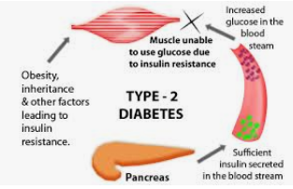

Slide 9
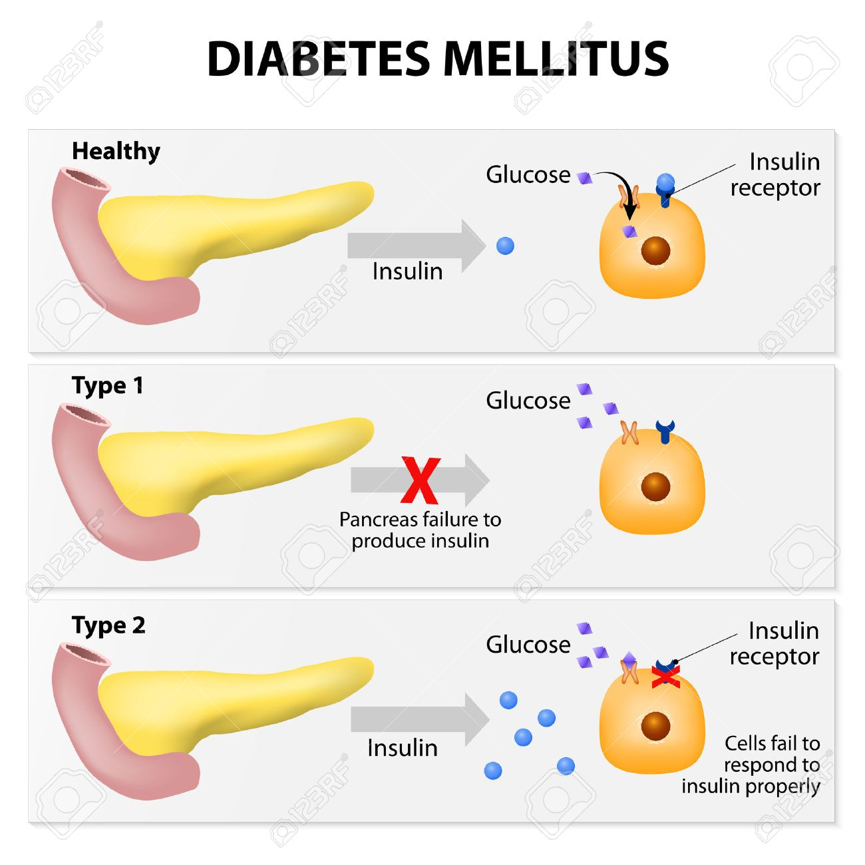

Slide 10
Gestational Diabetes
Gestational diabetes is high blood sugar that develops during pregnancy and usually disappears after giving birth.
It can occur at any stage of pregnancy, but is more common in the second half.
It occurs if your body cannot produce enough insulin to meet the extra needs in pregnancy.
Gestational diabetes can cause problems for the mother and her baby during and after birth.
But the risk of these problems happening can be reduced if it's detected and well managed.

Slide 11
Risks to the baby include
abnormal weight gain before birth
breathing problems at birth, and
higher obesity and diabetes risk later in life.
Risks to the mother include
needing a cesarean section due to an overly large baby
as well as damage to heart, kidney, nerves, and eye.

Slide 12
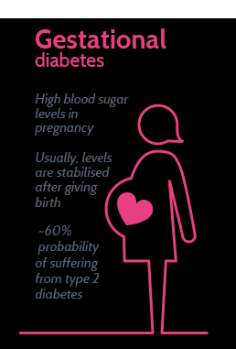

Slide 13
Malnutrition Related Diabetes Mellitus
Malnutrition-related diabetes mellitus (MRDM) is a rare type of diabetes associated with long term malnutrition.
This type of diabetes occurs on starvation when there is nothing that the insulin can act upon.
Or the body slowly reduces its production due to Negative Feedback control.

Slide 14
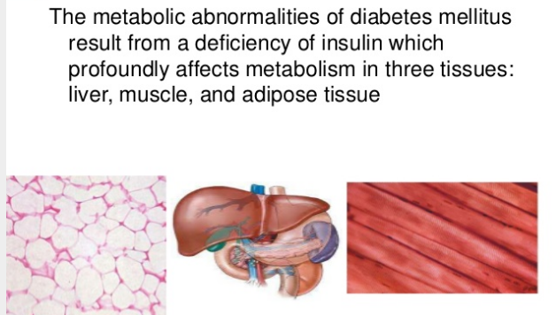
Metabolic Changes

Slide 15
Carbohydrate Metabolism-Hyperglycaemia
Diminished uptake of glucose by tissues- muscles , adipose tissues and liver
Over production of glucose – gluconeogenesis and glycogenolysis
Protein Metabolism- Negative nitrogen balance
Diminished uptake of amino acids and diminished synthesis of protein.
Increased proteolysis level
Fat Metabolism -Hypertriglyceridaemia
Increased Lipolysis
Decreased Lipogenisis
Increased production of triglyceride
Decreased removal of triglyceride

Slide 16
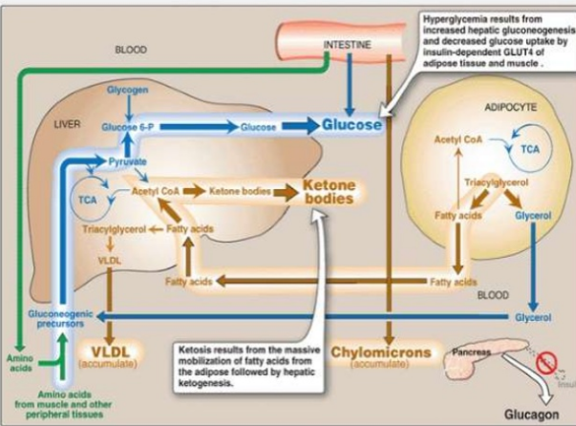

Slide 17
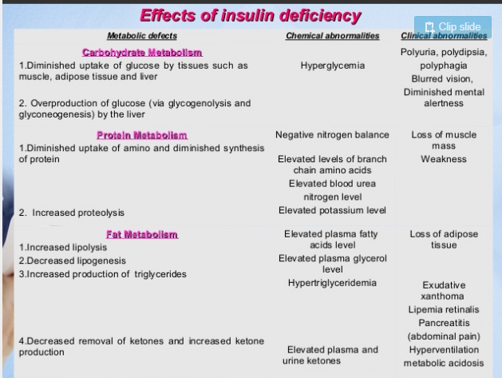
Symptoms

Slide 18
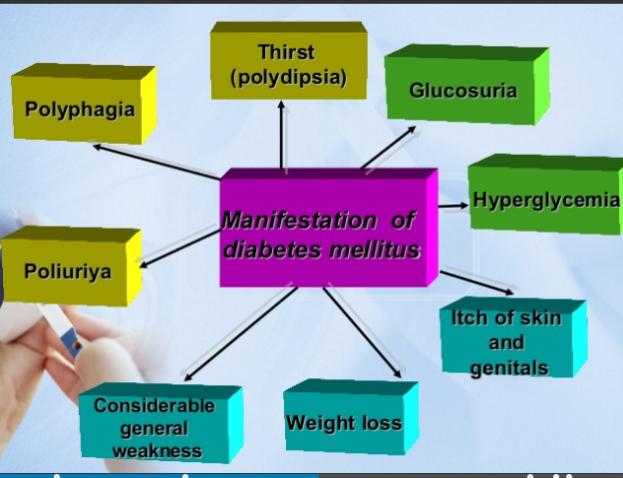

Slide 19
The abnormal concentration of glucose in the blood in diabetic patient draws water from the cells to the blood
When hyperglycemia exeeds the renal threshold ,the glucose is excreted in the urine (GLYCOSURIA).
With the loss of the cellular fluid , the patient experiences excessive Urination(POLYURIA) and excessive thirst (POLYDIPSIA).
The inability to metabolize glucose causes the body to breakdown its own tissues ,this causes excessive appetite (POLYPHAGIA).
At the same time a loss of weight , weakness and fatigue occurs.
The bodies use of protein from its own tissues lead to excretion of nitrogen and negative nitrogen balance

Slide 20
In uncontrolled diabetes the patient cannot use carbohydrates for energy , so excessive amounts of fats are broken down and consequently the liver produces the ketone bodies from the fatty acids (In a healthy individual the ketone bodies are broken down to carbondioxide and water yielding energy.
In a diabetic patient the fats breakdown faster than the body can handle leading to collection of ketones in the blood (KETONURIA)
Ketones are acids they lower the blood PH causing (ACIDOSIS) which can lead to DIABETIC COMA
Urinary tract and Vaginal infections are also common among diabetics.

Slide 21
In addition to above mentioned symptoms uncontrolled diabetes also leads to diseases of Vascular System.
ATHEROSCLEROSIS –A condition in which there is a heavy buildup of fatty substance inside the artery wall, reducing bloodflow.
Retinopathy-Retinal degeneration due to damage to the small blood vessel of the retina.
Neuropathy –Nerve damage
Nephropathy- Damage to the nephrons

Slide 22
Causes
Causes of type 1 diabetes
The exact cause of type 1 diabetes is unknown. What is known is that your immune system — which normally fights harmful bacteria or viruses — attacks and destroys your insulin-producing cells in the pancreas.
This leaves you with little or no insulin. Instead of being transported into your cells, sugar builds up in your bloodstream.
Type 1 is thought to be caused by a combination of genetic susceptibility and environmental factors, though exactly what those factors are is still unclear. Weight is not believed to be a factor in type 1 diabetes.

Slide 23
Risk factors for type 1 diabetes
Although the exact cause of type 1 diabetes is unknown, factors that may signal an increased risk include:
Family history. Your risk increases if a parent or sibling has type 1 diabetes.
Environmental factors. Circumstances such as exposure to a viral illness likely play some role in type 1 diabetes.
The presence of damaging immune system cells (autoantibodies). Sometimes family members of people with type 1 diabetes are tested for the presence of diabetes autoantibodies. If you have these autoantibodies, you have an increased risk of developing type 1 diabetes. But not everyone who has these autoantibodies develops diabetes.
Geography. Certain countries, such as Finland and Sweden, have higher rates of type 1 diabetes.

Slide 24
Causes of prediabetes and type 2 diabetes
In prediabetes — which can lead to type 2 diabetes — and in type 2 diabetes
your cells become resistant to the action of insulin, and your pancreas is unable to make enough insulin to overcome this resistance.
Instead of moving into your cells where it's needed for energy, sugar builds up in your bloodstream.
Exactly why this happens is uncertain, although it's believed that genetic and environmental factors play a role in the development of type 2 diabetes too.
Being overweight is strongly linked to the development of type 2 diabetes, but not everyone with type 2 is overweight.

Slide 25
Risk factors for prediabetes and type 2 diabetes
Researchers don't fully understand why some people develop prediabetes and type 2 diabetes and others don't. It's clear that certain factors increase the risk, however, including:
Weight. The more fatty tissue you have, the more resistant your cells become to insulin.
Inactivity. The less active you are, the greater your risk. Physical activity helps you control your weight, uses up glucose as energy and makes your cells more sensitive to insulin.
Family history. Your risk increases if a parent or sibling has type 2 diabetes.
Race. Although it's unclear why, people of certain races — including black people, Hispanics, American Indians and Asian-Americans — are at higher risk.
Age. Your risk increases as you get older. This may be because you tend to exercise less, lose muscle mass and gain weight as you age. But type 2 diabetes is also increasing among children, adolescents and younger adults.

Slide 26
Gestational diabetes. If you developed gestational diabetes when you were pregnant your risk of developing prediabetes and type 2 diabetes later increases. If you gave birth to a baby weighing more than 9 pounds (4 kilograms), you're also at risk of type 2 diabetes.
Polycystic ovary syndrome. For women, having polycystic ovary syndrome — a common condition characterized by irregular menstrual periods, excess hair growth and obesity — increases the risk of diabetes.
High blood pressure. Having blood pressure over 140/90 millimeters of mercury (mm Hg) is linked to an increased risk of type 2 diabetes.
Abnormal cholesterol and triglyceride levels. If you have low levels of high-density lipoprotein (HDL), or "good," cholesterol, your risk of type 2 diabetes is higher. Triglycerides are another type of fat carried in the blood. People with high levels of triglycerides have an increased risk of type 2 diabetes.

Slide 27
Causes of gestational diabetes
During pregnancy, the placenta produces hormones to sustain your pregnancy. These hormones make your cells more resistant to insulin.
Normally, your pancreas responds by producing enough extra insulin to overcome this resistance. But sometimes your pancreas can't keep up. When this happens, too little glucose gets into your cells and too much stays in your blood, resulting in gestational diabetes.

Slide 28
Risk factors for gestational diabetes
Any pregnant woman can develop gestational diabetes, but some women are at greater risk than are others. Risk factors for gestational diabetes include:
Age. Women older than age 25 are at increased risk.
Family or personal history. Your risk increases if you have prediabetes — a precursor to type 2 diabetes — or if a close family member, such as a parent or sibling, has type 2 diabetes.
You're also at greater risk if you had gestational diabetes during a previous pregnancy,
if you delivered a very large baby or if you had an unexplained stillbirth.
Weight. Being overweight before pregnancy increases your risk.
Race. For reasons that aren't clear, women who are black, Hispanic, American Indian or Asian are more likely to develop gestational diabetes.

Slide 29
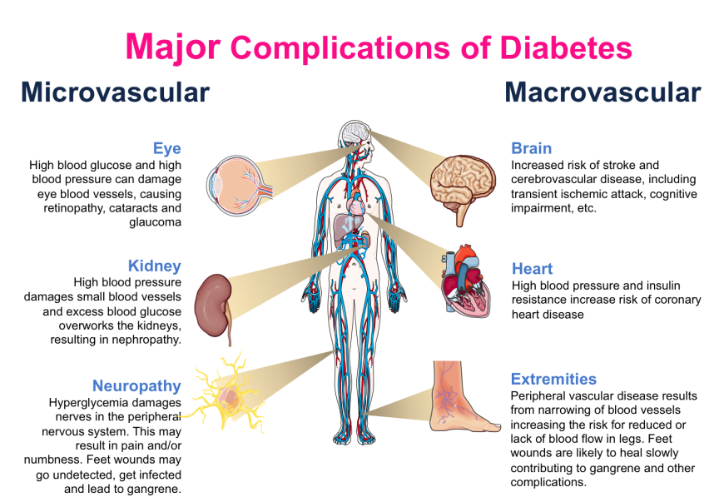
Complications

Slide 30
Long-term complications of diabetes develop gradually. The longer you have diabetes — and the less controlled your blood sugar — the higher the risk of complications. Eventually, diabetes complications may be disabling or even life-threatening. Possible complications include:
Cardiovascular disease. Diabetes dramatically increases the risk of various cardiovascular problems, including coronary artery disease with chest pain (angina), heart attack, stroke and narrowing of arteries (atherosclerosis). If you have diabetes, you're more likely to have heart disease or stroke.
Kidney damage (nephropathy). The kidneys contain millions of tiny blood vessel clusters (glomeruli) that filter waste from your blood. Diabetes can damage this delicate filtering system. Severe damage can lead to kidney failure or irreversible end-stage kidney disease, which may require dialysis or a kidney transplant.

Slide 31
Nerve damage (neuropathy). Excess sugar can injure the walls of the tiny blood vessels (capillaries) that nourish your nerves, especially in your legs. This can cause tingling, numbness, burning or pain that usually begins at the tips of the toes or fingers and gradually spreads upward.
Left untreated, you could lose all sense of feeling in the affected limbs. Damage to the nerves related to digestion can cause problems with nausea, vomiting, diarrhea or constipation. For men, it may lead to erectile dysfunction.

Slide 32
Eye damage (retinopathy). Diabetes can damage the blood vessels of the retina (diabetic retinopathy), potentially leading to blindness. Diabetes also increases the risk of other serious vision conditions, such as cataracts and glaucoma.
Foot damage. Nerve damage in the feet or poor blood flow to the feet increases the risk of various foot complications. Left untreated, cuts and blisters can develop serious infections, which often heal poorly. These infections may ultimately require toe, foot or leg amputation.
Skin conditions. Diabetes may leave you more susceptible to skin problems, including bacterial and fungal infections.

Slide 33
Complications in your baby can occur as a result of gestational diabetes, including:
Excess growth. Extra glucose can cross the placenta, which triggers your baby's pancreas to make extra insulin. This can cause your baby to grow too large (macrosomia). Very large babies are more likely to require a C-section birth.
Low blood sugar. Sometimes babies of mothers with gestational diabetes develop low blood sugar (hypoglycemia) shortly after birth because their own insulin production is high. Prompt feedings and sometimes an intravenous glucose solution can return the baby's blood sugar level to normal.
Type 2 diabetes later in life. Babies of mothers who have gestational diabetes have a higher risk of developing obesity and type 2 diabetes later in life.
Death. Untreated gestational diabetes can result in a baby's death either before or shortly after birth.

Slide 34
Complications in the mother also can occur as a result of gestational diabetes, including:
Preeclampsia. This condition is characterized by high blood pressure, excess protein in the urine, and swelling in the legs and feet. Preeclampsia can lead to serious or even life-threatening complications for both mother and baby.
Subsequent gestational diabetes. Once you've had gestational diabetes in one pregnancy, you're more likely to have it again with the next pregnancy. You're also more likely to develop diabetes — typically type 2 diabetes — as you get older.

Slide 35
Diagnosis
Fasting plasma glucose test
measures your blood glucose after you have gone at least 8 hours without eating.
This test is used to detect diabetes or prediabetes.
Fasting Plasma Glucose (FPG) Test
The FPG is most reliable when done in the morning. If your fasting glucose level is 100 to 125 mg/dl, you have a form of prediabetes called impaired fasting glucose (IFG), meaning that you are more likely to develop type 2 diabetes but do not have it yet.
A level of 126 mg/dl or above, confirmed by repeating the test on another day, means that you have diabetes.

Slide 36
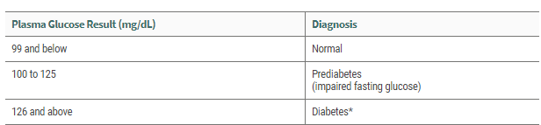

Slide 37
Oral glucose tolerance test
measures your blood sugar after you have gone at least eight hours without eating and two hours after you drink a glucose-containing beverage.
This test can be used to diagnose diabetes or prediabetes.
Oral Glucose Tolerance Test (OGTT)
Research has shown that the OGTT is more sensitive than the FPG test for diagnosing prediabetes, but it is less convenient to administer.
The OGTT requires you to fast for at least eight hours before the test.

Slide 38
Your plasma glucose is measured immediately before and two hours after you drink a liquid containing 75 grams of glucose dissolved in water.
If your blood sugar level is between 140 and 199 mg/dl 2 hours after drinking the liquid
You have a form of prediabetes called impaired glucose tolerance or IGT, meaning that you are more likely to develop type 2 diabetes but do not have it yet.
A two-hour glucose level of 200 mg/dl or above, confirmed by repeating the test on another day, means that you have diabetes.

Slide 39
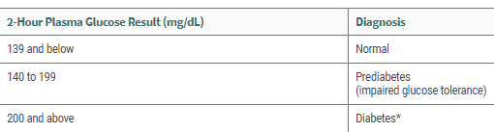

Slide 40
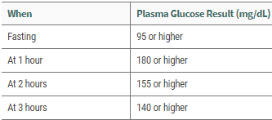
Gestational diabetes is also diagnosed based on plasma glucose values measured during the OGTT.
Blood sugar levels are checked four times during the test.
If your blood sugar levels are above normal at least twice during the test, you have gestational diabetes.

Slide 41
Random plasma glucose test,
your doctor checks your blood sugar without regard to when you ate your last meal.
This test, along with an assessment of symptoms, is used to diagnose diabetes, but not prediabetes.
Positive test results should be confirmed by repeating the fasting plasma glucose test or the oral glucose tolerance test on a different day.

Slide 42
Random Plasma Glucose Test
A random blood glucose level of 200 mg/dl or more, plus presence of the following symptoms, can mean that you have diabetes:
Increased urination
Increased thirst
Unexplained weight loss

Slide 43
Glycated hemoglobin test (A1C)
This blood test which doesn’t require fasting ,indicates your average blood sugar level for the past two to three months .
It measures the percentage of blood sugar attached to hemoglobin .
The higher your blood sugar level , the more hemoglobin you will have with sugar attached .
An A1C level of 6.5 % or higher on two separate test indicate that you have diabetes.
An A1C between 5.7 and 6.4 % indicates prediabetes.
Below 5.7 % is considered normal

Slide 44
Ketonuria
High amounts of ketone bodies excreted can be detected in the urine by Nitroprusside reaction which is carried out using Acetest tablets or Ketostix paper sticks
If both ketonuria and glycosuria are found the diagnosis of diabetes is certain.

Slide 45
When first diagnosed with diabetes, your doctor may suggest a zinc transporter 8 autoantibody (ZnT8Ab) test.
This blood test -- along with other information and test results -- can help determine if a person has type 1 diabetes and not another type.
The goal of having the ZnT8Ab test is a prompt and accurate diagnosis and that can lead to timely treatment.

Slide 46
Treatment
Exercise
Regular exercise is necessary for the management of diabetes .
It lowers or eliminates the need for insulin and drugs.
Decreases insulin resistance
Helps in management of weight
Lowers triglyceride and increases the HDL levels
Improves circulation through out the body
Reduces stress
Reduces high blood pressure

Slide 47
Each patient must follow a systematic pattern and perform these exercise under proper guidance.
As they may lead to hypoglycaemic reaction.
Diet and drug dosage must be altered according to the exercise performed.
Moderate intensity exercise a diabetic can do include half an hour of brisk walking , jogging , cycling leasurely , playing tennis , swimming ,gardening and golfing

Slide 48
Insulin and diet.
People with type 1 diabetes need insulin therapy to survive.
Many people with type 2 diabetes or gestational diabetes also need insulin therapy.
Many types of insulin are available, including rapid-acting insulin, long-acting insulin and intermediate options.
Depending on your needs, your doctor may prescribe a mixture of insulin types to use throughout the day and night.
Insulin can't be taken orally to lower blood sugar because stomach enzymes interfere with insulin's action.
Often insulin is injected using a fine needle and syringe or an insulin pen a device that looks like a large ink pen.

Slide 49
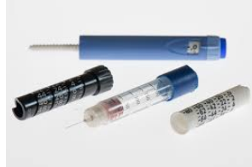
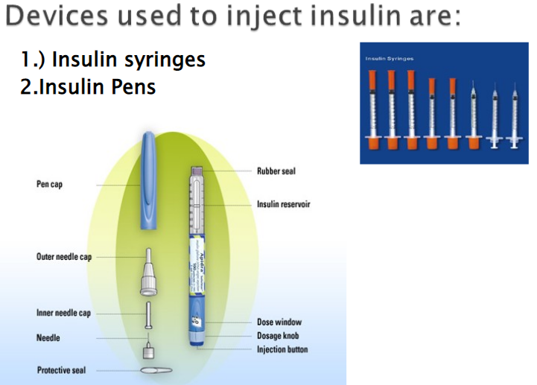

Slide 50
In a healthy person insulin secretion matches the food intake where as in a type 1 diabetic patient the food intake has to be matched to the insulin intake.
Type of Insulin and their action
Rapid-acting insulin : The effect on the blood glucose level can be detected in about an hour peaks at 4-6hours and can last about 12 -16 hours
Intermediate-acting insulin: The effect is detected in about 2 hours peak at about 11 hours and can last about 22-29 hours
Long-acting insulin: The effect on the blood glucose level can be detected in about 4 to 8 hours peaks at 14 to 20 hours and can last about 24 to 36 hours.

Slide 51
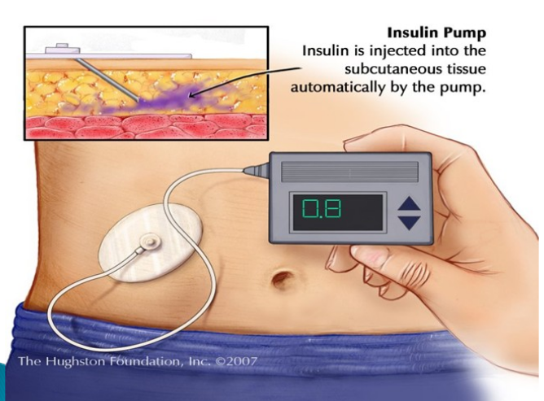

Slide 52
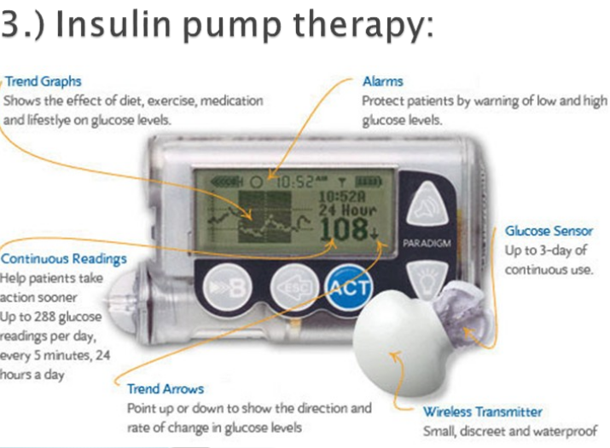

Slide 53
An emerging treatment approach, is closed loop insulin delivery, also known as the artificial pancreas. It links a continuous glucose monitor to an insulin pump, and automatically delivers the correct amount of insulin when needed.
There are a number of versions of the artificial pancreas, and clinical trials have had encouraging results. More research needs to be done before a fully functional artificial pancreas receives regulatory approval.
However, progress has been made toward an artificial pancreas. In 2016, an insulin pump combined with a continuous glucose monitor and a computer algorithm was approved by the Food and Drug Administration.
However, the user still needs to tell the machine how many carbohydrates will be eaten .

Slide 54
Hypoglycaemic drugs.
Sometimes other oral or injected medications are prescribed as well.
Some diabetes medications stimulate your pancreas to produce and release more insulin.
Others inhibit the production and release of glucose from your liver, which means you need less insulin to transport sugar into your cells.
Still others block the action of stomach or intestinal enzymes that break down carbohydrates or make your tissues more sensitive to insulin.
Metformin (Glucophage, Glumetza, others) is generally the first medication prescribed for type 2 diabetes.

Slide 55
Dietary Management
Nutrition and physical activity are important parts of a healthy lifestyle when a person has diabetes.
•Along with other benefits, following a healthy meal plan and being active can help him keep his blood sugar under control.
A diabetic diet need not be a complete deviation from the normal diet.
Portion control and balance of nutrients consumed at regular intervals is the basis of glucose control

Slide 56
No single meal plan or eating pattern works for everyone with diabetes.
The nutrients have to be tailored according to individual need depending on Age , sex, weight , height , physical activity and physiological need of the patient.
To manage the blood glucose, the patient needs to balance what he eats and drinks with physical activity and medication

Slide 57
Energy
Based on the nature of physical activity , body weight and dietary history the total daily requirements of calories are calculated.
A diabetic should achieve and maintain desirable body weight ,10% below IBW should be maintained.
To attain this goal ,calorie intake is regulated
After the desirable body weight is determined , calorie requirement is estimated as follows
Overweight diabetic ; 20-25 kcal /kg body weight /day
Ideal weight diabetic; 30-35 kcal/kg body weight /day
Under weight diabetic;40-45 kcal/kg body weight/day
In persons above 50 years 10% less calorie for each decade.

Slide 58
Children need greater energy requirement than adults for their growth and development.
Calorie requirement for children are
1000 basal calories + 125 calories for boys for every year
1000 basal calories + 100 calories for girls for every year
Example –A 10 yr old boy requires 1000+ 125x10=2250 kcal

Slide 59
Carbohydrates
CHO is maintained to 45-60% of total calories
Minimum amt of CHO – 130g to prevent ketosis
Carbohydrates should be in form of polysaccharides such as whole grains.
Avoid mono and disaccharides like sweets , chocolates and sweet juices .
Protein
The normal RDA for protein is 10-35% of total calories .
In Type1 Diabetic children 1-1.5 g / kg body weight is recommended.
High protein intake helps in increased insulin production and promotes satiety.
It supplies essential amino acids for tissue repair.

Slide 60
Fats
Total fat intake is 15-25% of the day’s energy intake
Low fat diet increases insulin binding .
Reduces LDL and VLDL , hence reducing the risk of Atherosclerosis.
Blend of oils are preferred than a single oil, Include polyunsaturated and monounsaturated oils.
Avoid saturated and trans fat
Daily intake of cholesterol should be limited to 300mg or less.
Vitamin and Minerals
Supplementations are recommended depending on the need.
Sodium
The daily intake of sodium is restricted to 3000mg per day ,especially for patients having hypertension, nephropathy and heart failure.

Slide 61
Dietary guidelines for a diabetic patient
Include 3 main meals with in between smaller snacks.
Avoid junk foods
Follow the food exchange list to avoid monotony and to provide flexiblity in the diet.
Avoid Feasting and Fasting
Diet should be rich in antioxidants , micronutrients and phytochemicals.
Include foods like fenugreek as they have mucilaginous fibre and total fibre (20 and 50%), it also contains Trigonelline ( alkaloid) which reduces blood sugar level , it also reduces the cholesterol and triglyceride levels.
Whole wheat is preferred to rice as it contains acrabose (alpha –glucosidase inhibitors ) which is an anti hyperglycemic agent.

Slide 62
Role of Fibre
Dietary fibre and complex carbohydrates are beneficial to diabetes patients they-
Lower the insulin requirement
Increase peripheral tissue insulin sensitivity
Decrease serum cholesterol and triglyceride levels
Aid in weight control
Lowers the B.P
25-40 g of dietary fibre /1000kcal can be included
Soluble fibre such as pectin , gums, hemicellulose delays the gastric emptying ,slows the glucose absorption and lowers serum cholesterol.
Insoluble fibre such as cellulose and lignin ( vegetables , grains) Increase faecal bulk , delay glucose absorption and slow starch hydrolysis.
Include legumes , whole grain , and fenugreek seeds

Slide 63
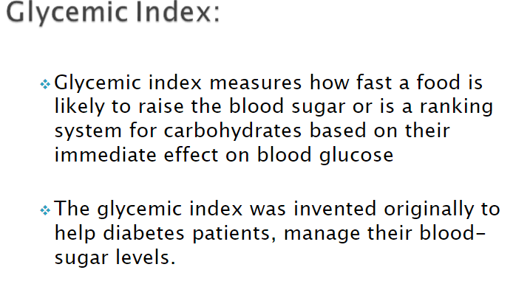

Slide 64
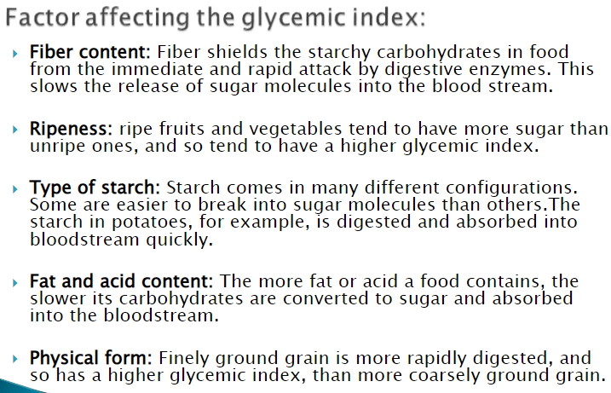

Slide 65
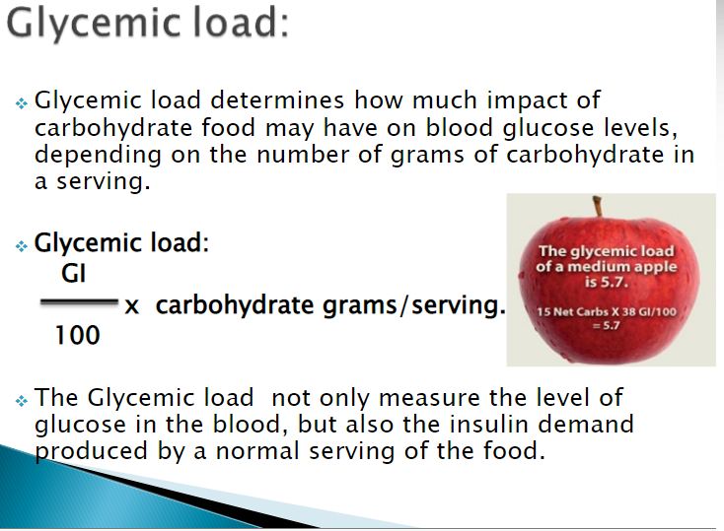

Slide 66
Food Exchange list
• Diabetic food exchanges are an easy way to create a meal plan that has a variety of choices while making sure that the consumption of carbohydrates is controlled .
The Exchanges in Food Exchange List are a carbohydrate-counting diet system focusing on the needs of diabetics.
Counting carbohydrates gives you a better awareness of your eating habits, which helps to control your blood sugar, keep you in balance with your medications, and manage your body weight.

Slide 67
The objective of using the exchange system in daily diet is to maximize the nutritional content of food while minimizing the effects it has on blood sugar.
Similar foods are grouped into categories — or "exchanges" — that have the same amounts of carbohydrates, protein, calories and fat.
Foods on the same list can be exchanged for each other, to give variety and choice to an otherwise structured meal plan
They have similar effect on the blood glucose as a serving of food in that same group .

Slide 68
For instance, say your snack can have two carbohydrate exchanges.
That would mean you could choose to have
Two slices of bread, or a cup of milk and an apple. You can mix and match according to your preferences.
The exchange system gives you a way to quantify how much of what kind of food you can have.
For even more options and variety, there is a list of "free" foods that can be consumed without counting.

Slide 69
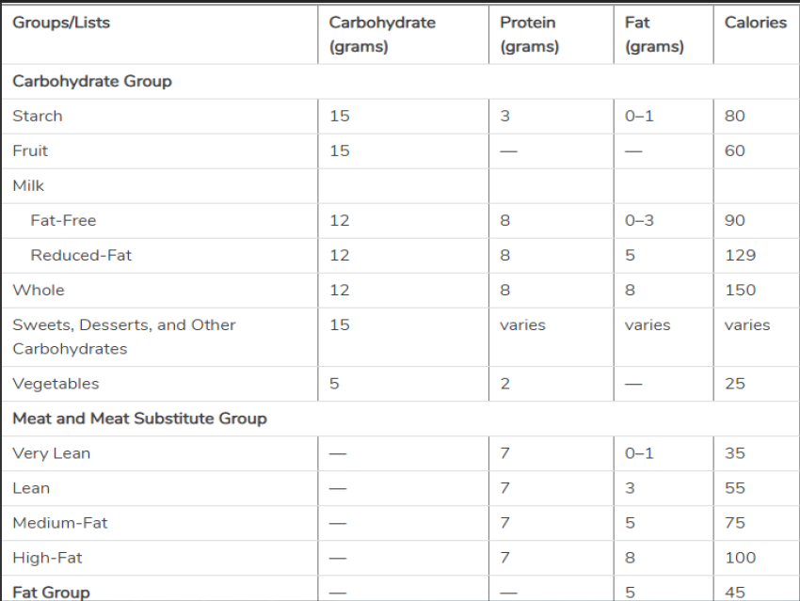

Slide 70
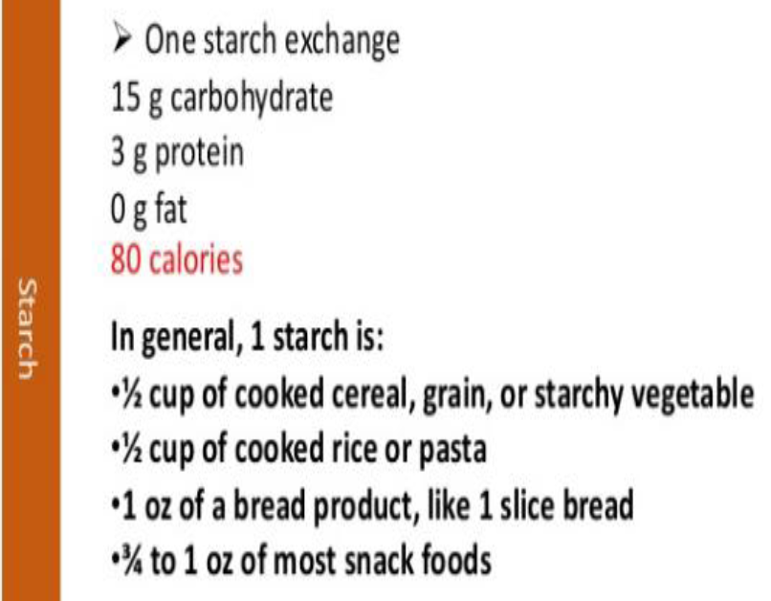

Slide 71
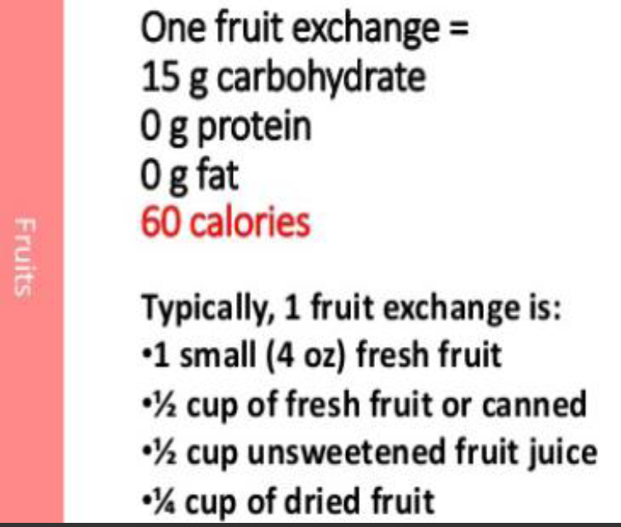

Slide 72
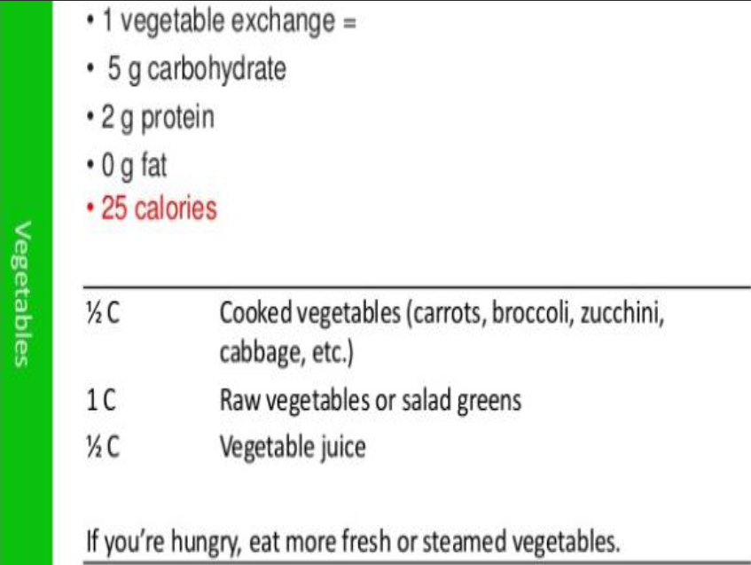

Slide 73
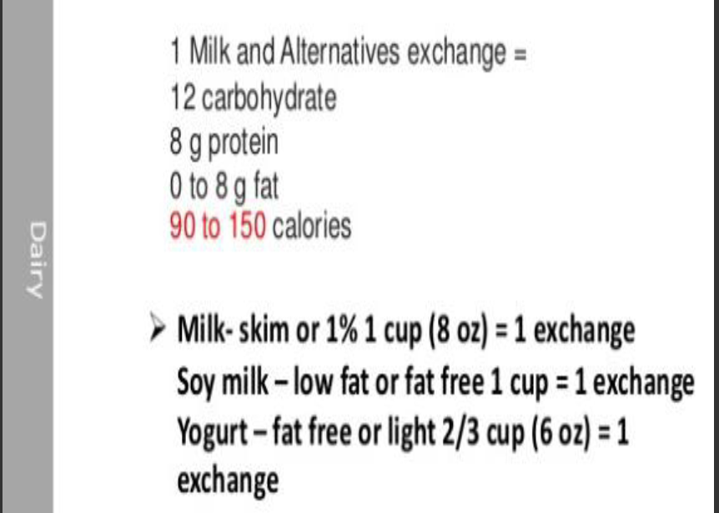

Slide 74
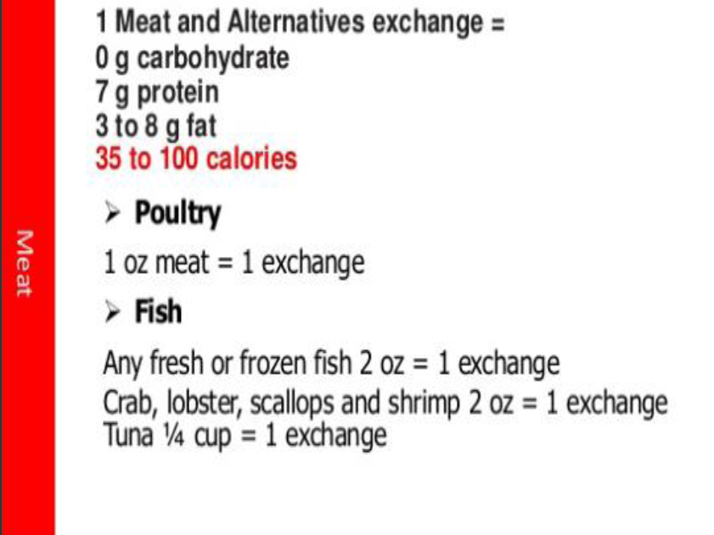

Slide 75
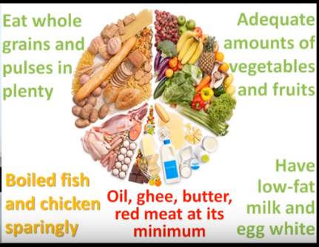

Slide 76


